Slide 1
Apollo Renal Therapeutics Water Filtration Project
Team 504
Kencin Autry, Matthew Kennedy, Timothy Norman,
Lapadre Proctor, Lily Thompson

Slide 2
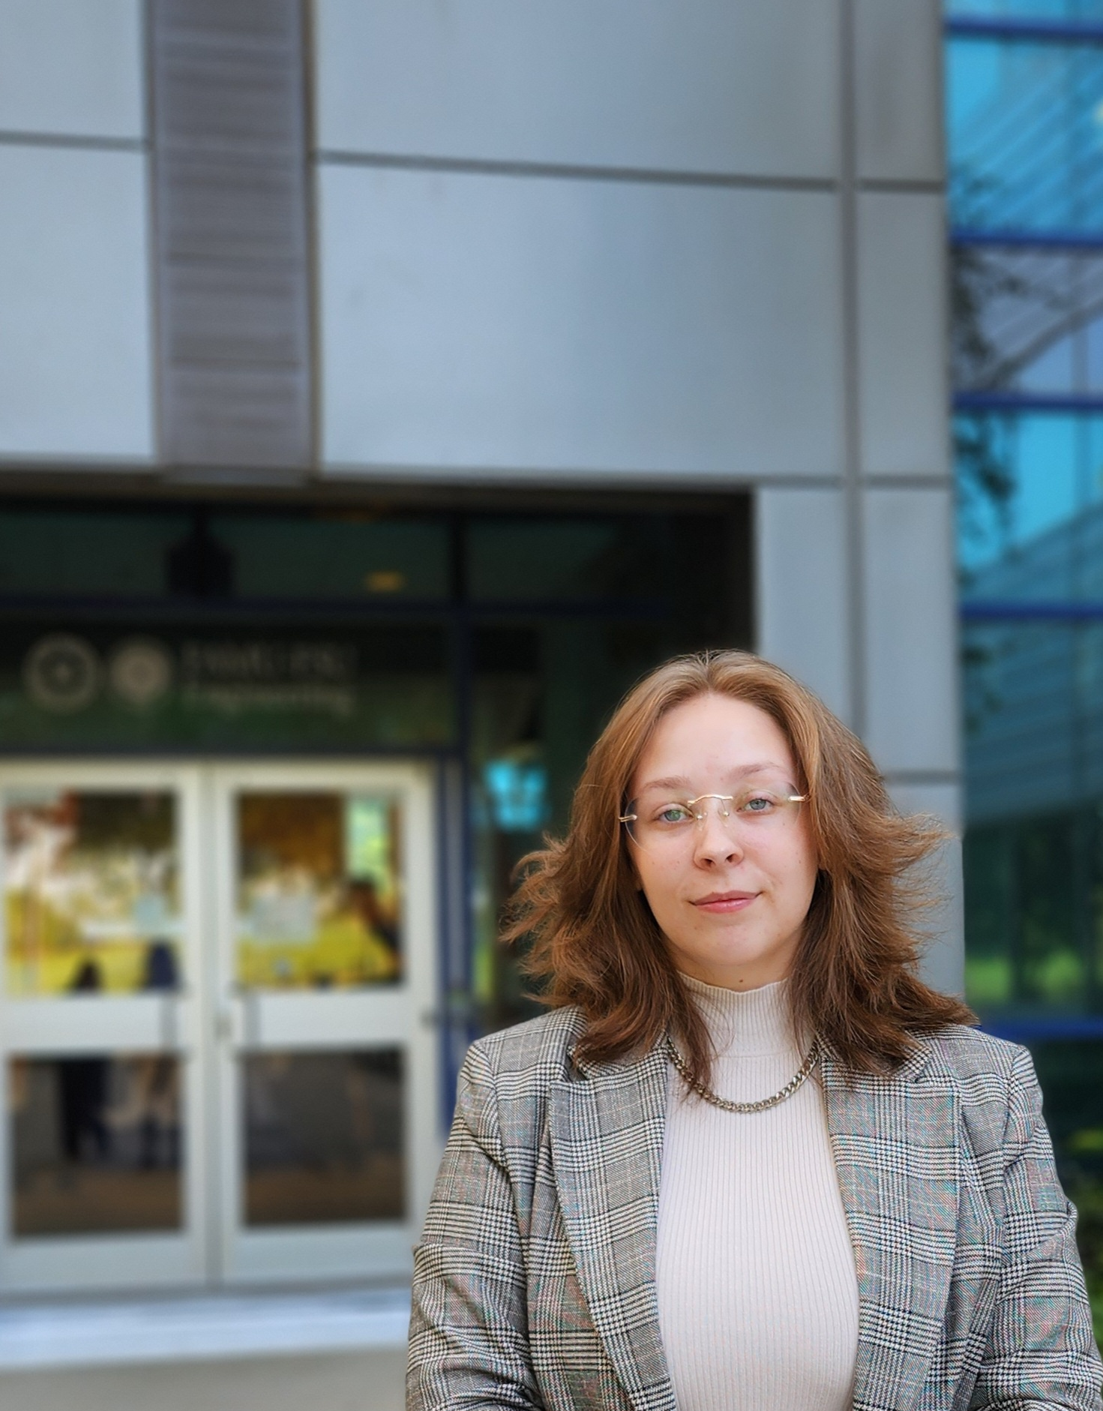
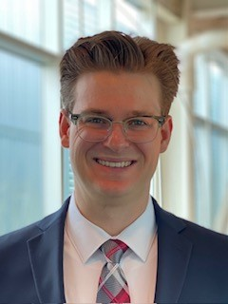
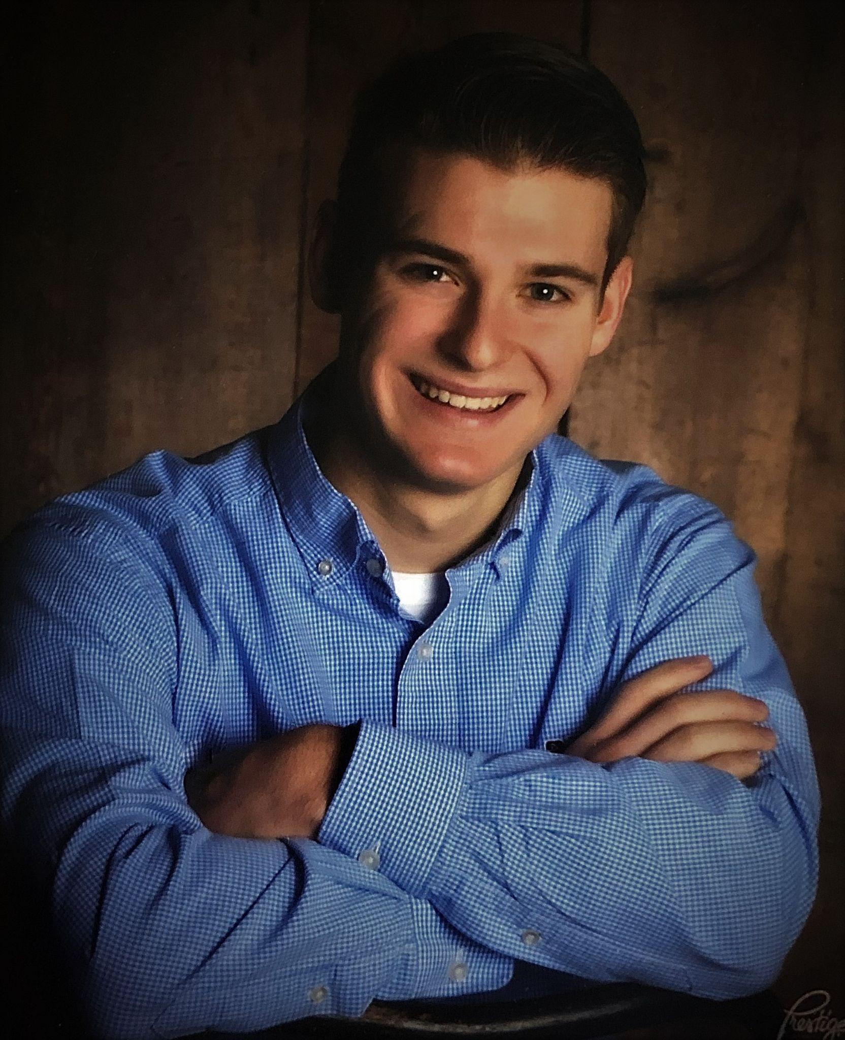
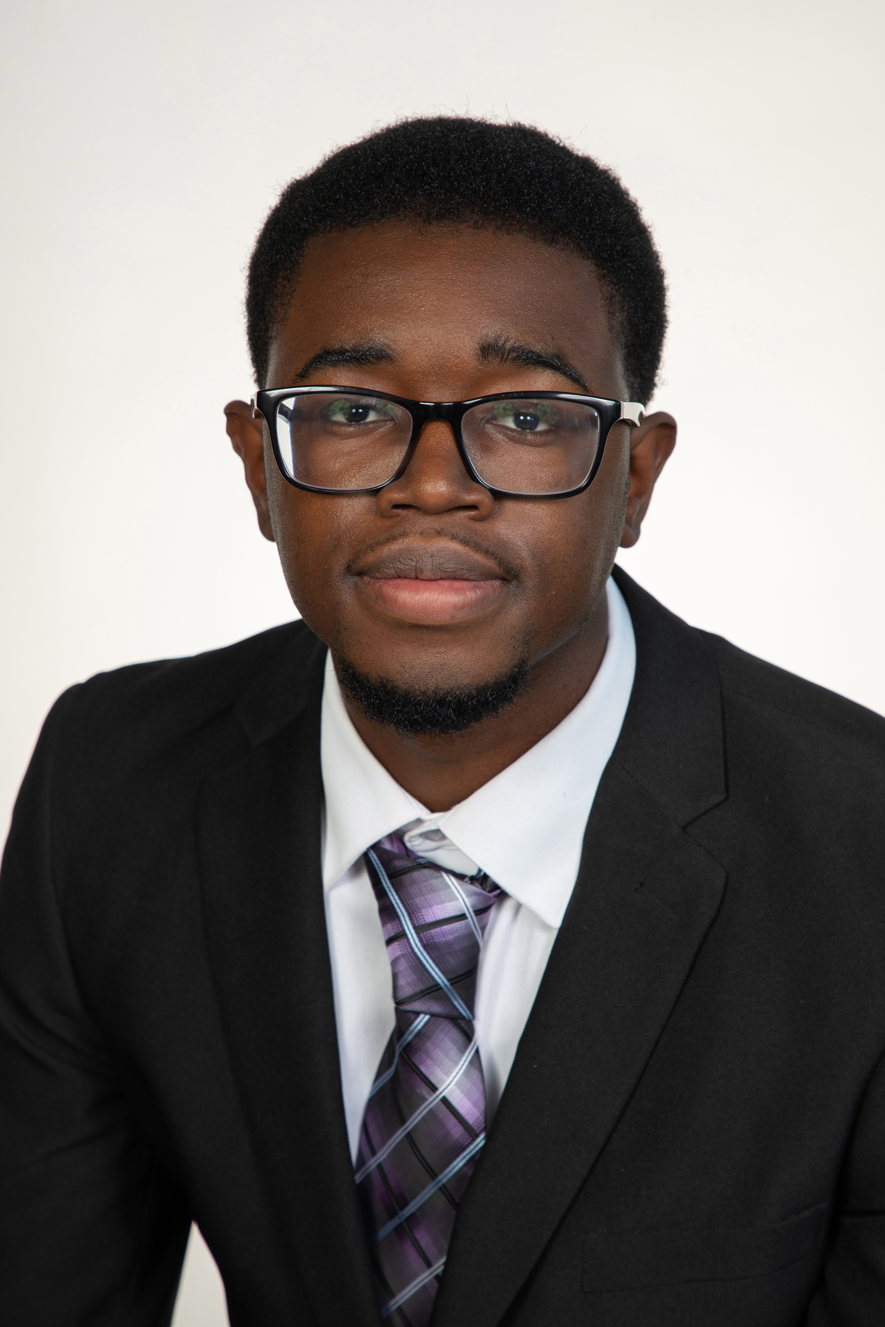
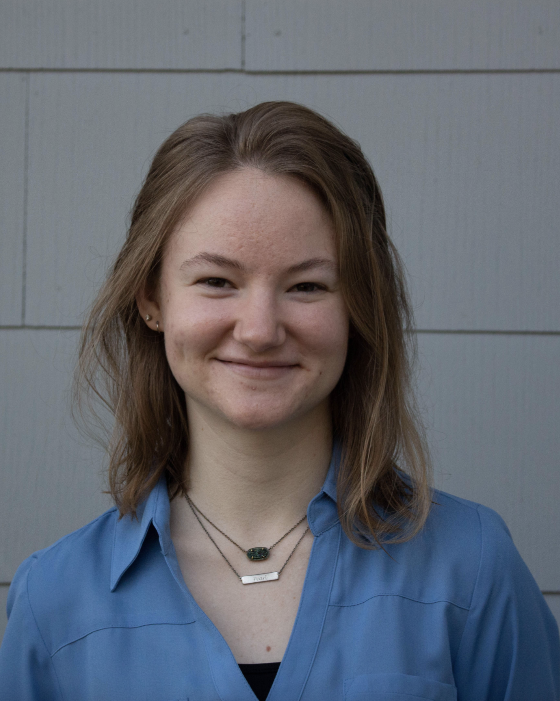
Lily Thompson
Team Introductions
Kencin Autry
Research
Development
Engineer
Matthew Kennedy
Structural Design
And Materials
Engineer
Timothy Norman
Structural Design
And Manufacturing
Engineer
Lapadre Proctor
Test and Quality
Control Engineer
Lily Thompson
Computational
Fluids Engineer
2

Slide 3
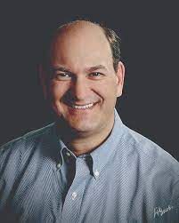
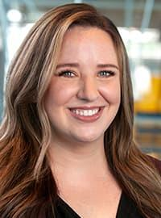
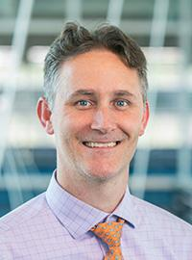
Lily Thompson
Sponsor and Advisor
Sponsor
Gary Mishkin
CEO Apollo Renal Therapeutics
DBA Artemis Plastics
Academic Advisor
Dr. Rebekah Sweat
Assistant Professor
Academic Advisor
Dr. Shayne McConomy
Senior Design Professor

Slide 4
Lily Thompson
Objective
The objective of this project is to reduce the quantity of waste-water in the dialysis process by efficiently purifying standardized filtered water and spent dialysate to ultra-pure water.
Notes:
l

Slide 5
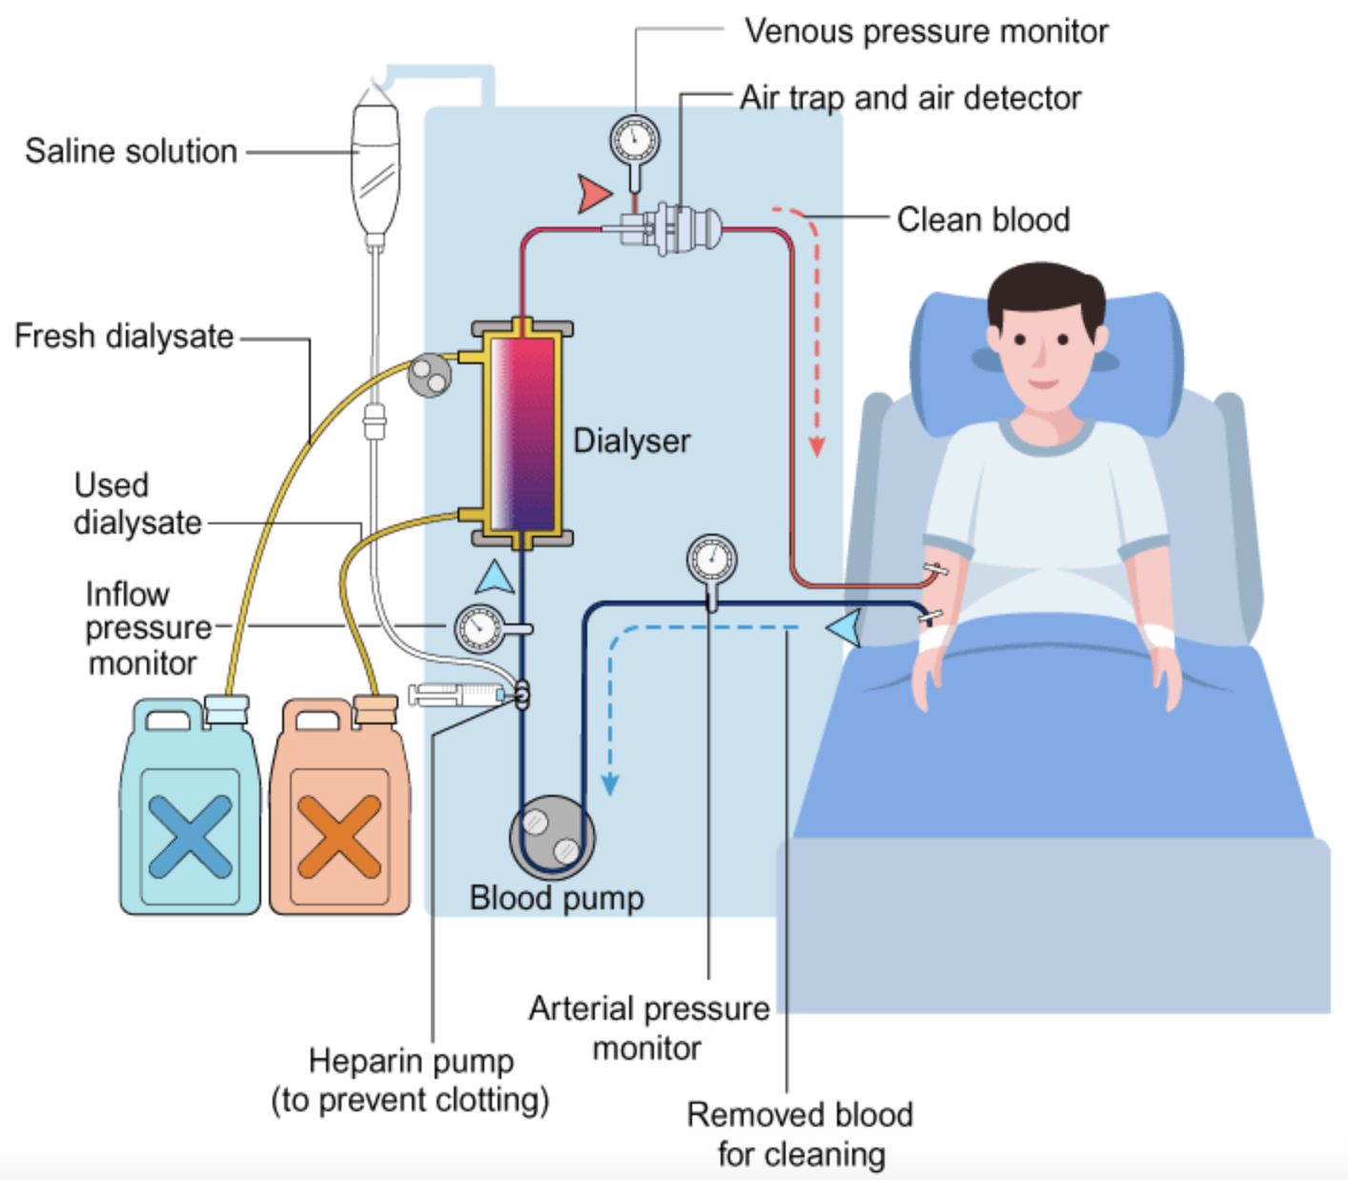
Lily Thompson
Project Background
Hemodialysis is a therapy treatment for patients with end-stage kidney disease (ESKD).
5

Slide 6
Lily Thompson
Hemodialysis Process
6

Slide 7
Lily Thompson
Key Goals
Enhancing efficiency and preventing the potential hazards of large water filtration systems
Use the device at the home of patients
Recycling spent dialysate back into ultra-pure water
Filtered water will meet ultra-pure water standards
7

Slide 8
Lily Thompson
Customer Needs
Design requires relatively low maintenance and will last approximately 1 year
Design should fit into a space no larger than 10 in x 12 in x 5 in
Must be universally compatible
Handle a maximum flow rate of 1000 mL per minute
Produce Ultra-Pure water
8
8
8

Slide 9
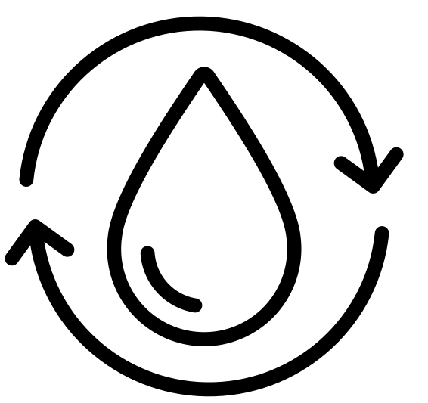
Critical Targets and Metrics
Lily Thompson
Purify Water
Recycle Spent Dialysate
Ergonomic Compatibility
Raise and Lower Flow Rate
< 0 ppm TDS
75% Efficiency
10 x 12 x 5 in
100 – 1000 mL per minute

Slide 10
Concept Generation
Lily Thompson
Secondary Dialyzer
Lego Sorter
Nanofiltration and Reverse Osmosis
Chemical Coagulant
Nanofiltration
Notes:
Do we wanna include all of this???

Slide 11
High-Fidelity
Lily Thompson
Carbon Nanotube and Ultrasonics
Forward Osmosis
Gaseous Ozone

Slide 12
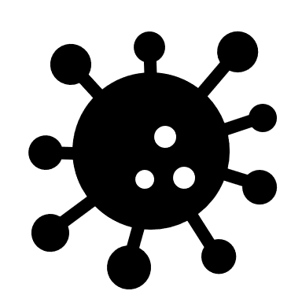
Carbon Nanotube and Ultrasonics
Lily Thompson

Slide 13
Final Concept
Lily Thompson
Reverse Osmosis (RO)
Nano-Filtration (CNTs)

Slide 14
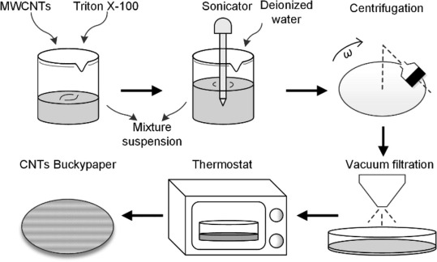
“Bucky paper” Production
Kencin Autry
Not capable of vertical alignment in the membrane
Variable thickness, but not in diameter
Can differ the density of CNTs
Notes:
* May animate the process instead

Slide 15
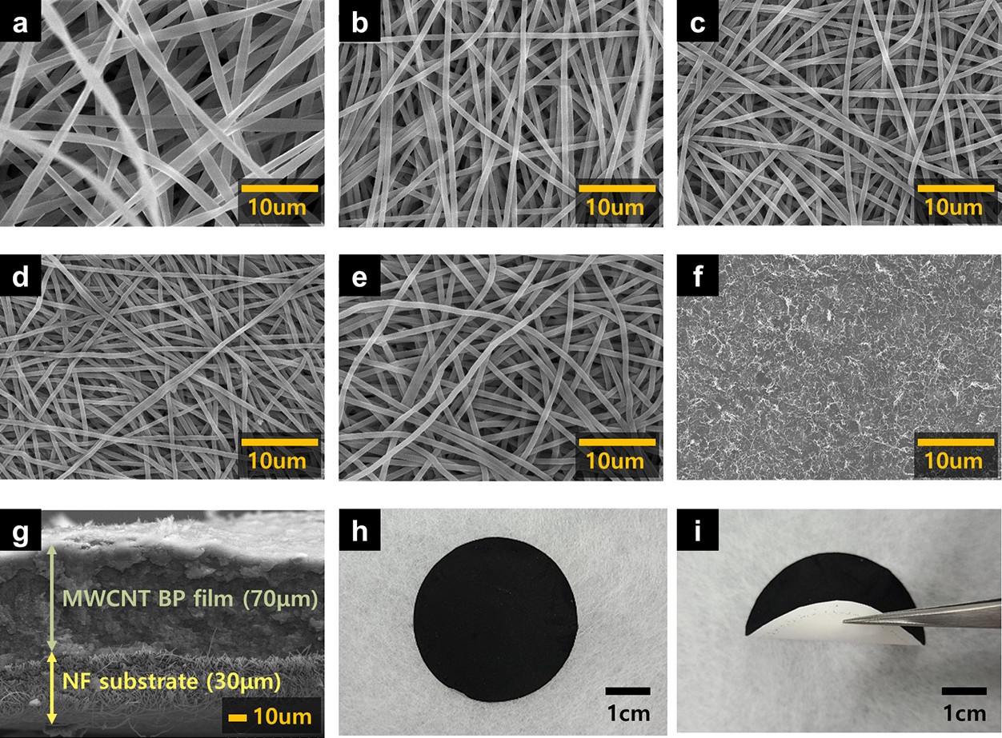
Bucky Paper CNT Film
Kencin Autry
MWCNT Film
SWCNT Film
Combination
Evaluating varying Bucky paper thicknesses with Dr. Sweat

Slide 16
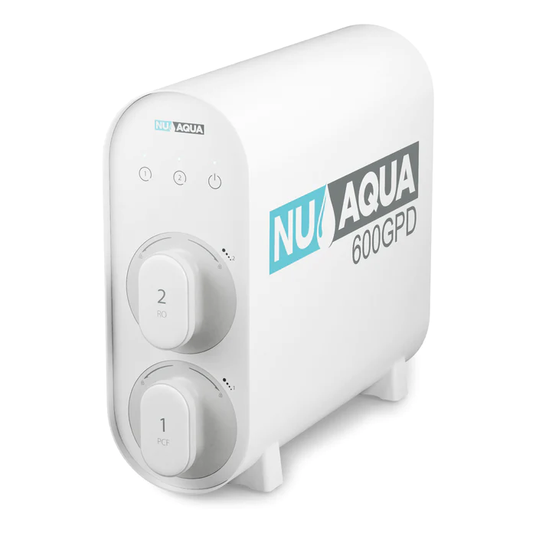
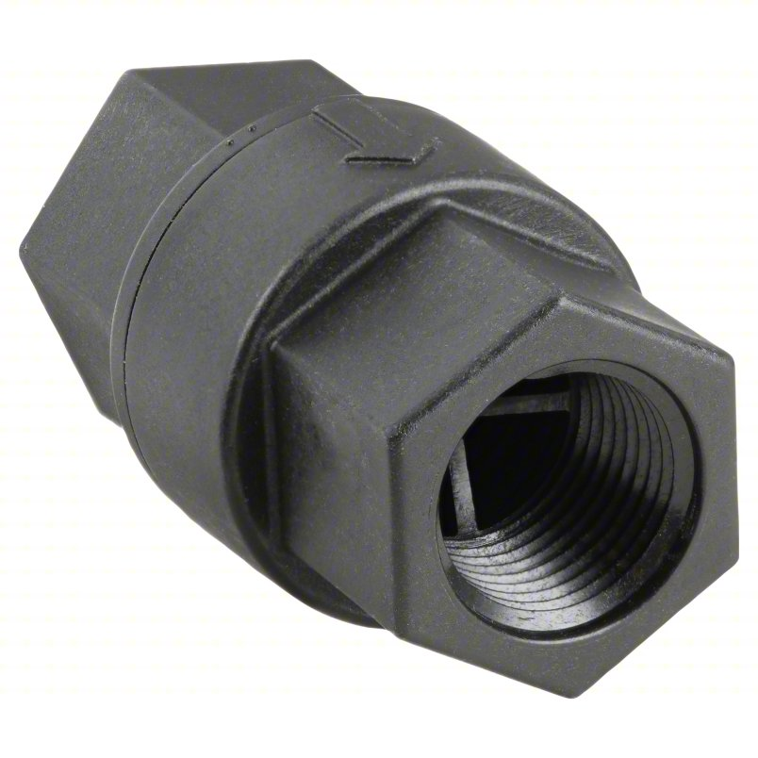
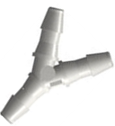
Kencin Autry
RO System
Filtered
Water Runoff
Check Valves
CNT Filter
Primary Pump
Spent Dialysate Runoff

Slide 17
RO System
Kencin Autry
Claims to remove 99% of contaminants for drinking water standards
Filters last 12 – 24 months
Incoming water must be between 14.5 and 58 psi
Filters at 1590 mL per minute
Will have to adapt to two water inputs
Notes:
Should we go into the individual components?

Slide 18
Primary Pump
Kencin Autry
24V Stepper motor
Silicone tube,7.9mm ID × 11.1mm OD
Flow Rate of 1600ml/min
Ambient temperature 0-40℃
Relative humidity <80%
Reduction ratio 1:20
Notes:
Should we go into the individual components?

Slide 19
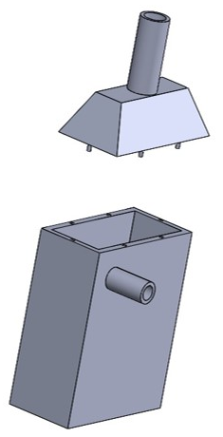
Initial vs Future Filter Prototype
Kencin Autry
Surrounding Shell
Ultrasonic Generator
CNT Membrane

Slide 20
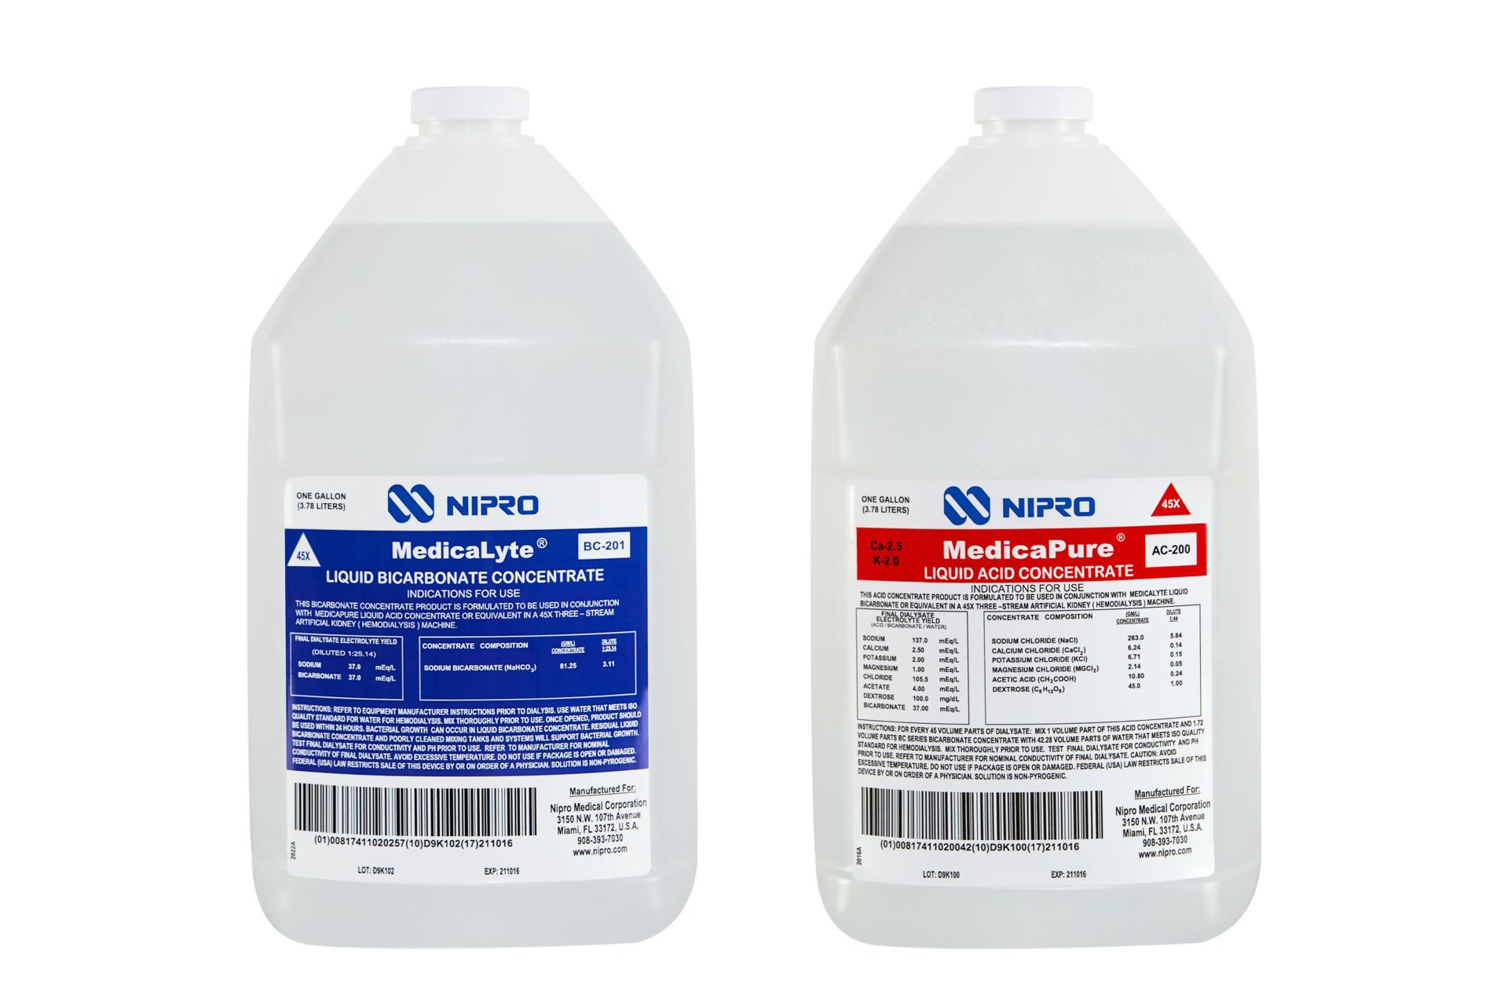
Testing Methods
Kencin Autry
Sodium: Na
Bicarbonate: HCO3
Potassium: K
Calcium: Ca
Magnesium: Mg
Chlorine: Cl
Sodium: Na
Notes:
*thoughts on needing to mention this in terms of simulating dialysate

Slide 21
Testing Methods
Kencin Autry
TDS : 0 – 19.99 ppt
Conductivity
Water Temp
Filtered Water
pH
Notes:
https://www.grainger.com/product/EXTECH-Conductivity-Meter-38W993

Slide 22
Testing Methods
Kencin Autry
Filtered Water
Notes:
Urea raises the pH and

Slide 23
Future Work
Kencin Autry
Concept
Selection
Develop CNT Membrane and Housing
Testing and Verification of
Fluid Flow
Connect Piping and Water System
Testing and Verification of Water Quality
23

Slide 24
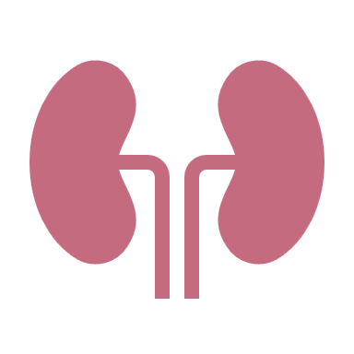
LinkedIn
Thank You
Kencin Autry
Matt Kennedy
Lily Thompson
Lapadre Proctor
Timothy Norman
Notes:
Add groups linked in info in QR code

Slide 25
Backup Slides

Slide 26
Ultra-Pure Standards Table

Slide 27
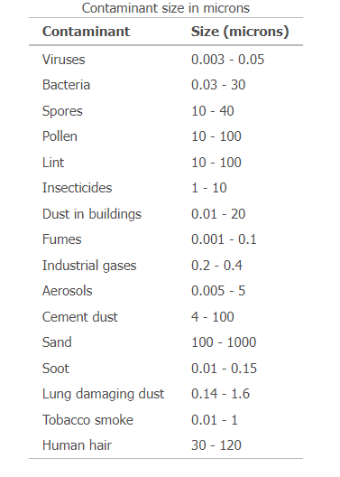
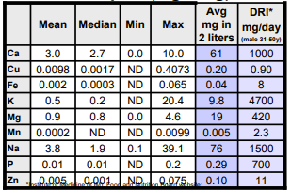
Contaminants Found in Tap Water

Slide 28
Standards for Ultra-Pure Water
Ultrapure water (UPW) is water that has been purified to high levels of specification:
Extremely low total dissolved solids (TDS) level
High electrical resistivity
Free from chloride, sulfate, sodium, calcium, magnesium
Minimal levels of organic contaminants, > 1 ppb

Slide 29
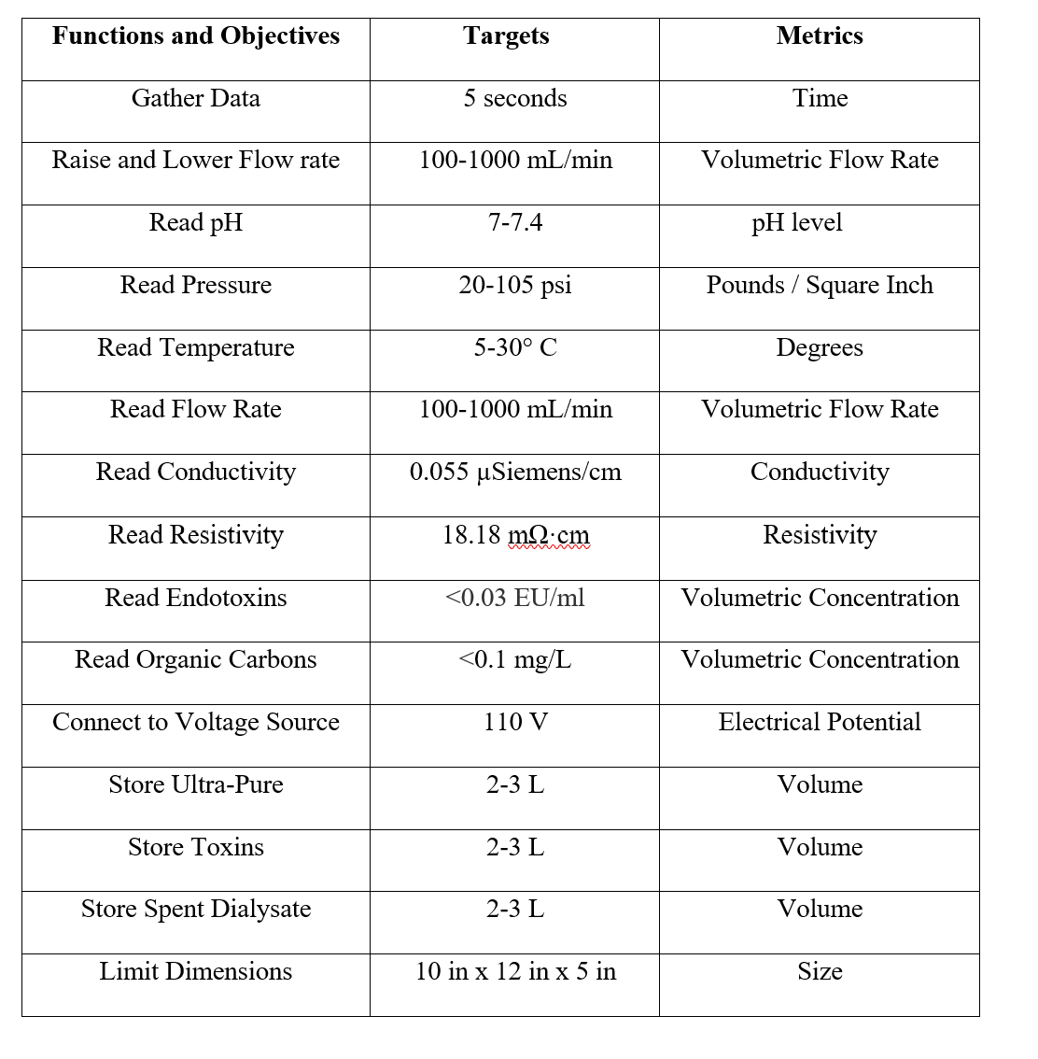
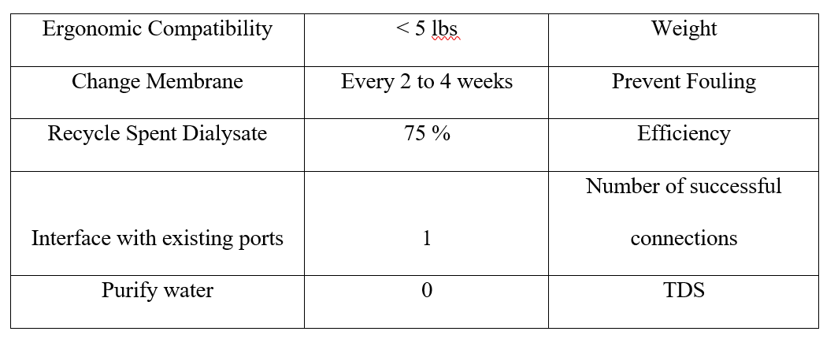
Targets and Metrics Table

Slide 30
Concept Selection
Matt Kennedy
Analytical Hierarchy Process
Concept | Alternative Value
Nano-filtration and Reverse Osmosis | 0.247
Nano-filtration | 0.382
Forward Osmosis | 0.382

Slide 31
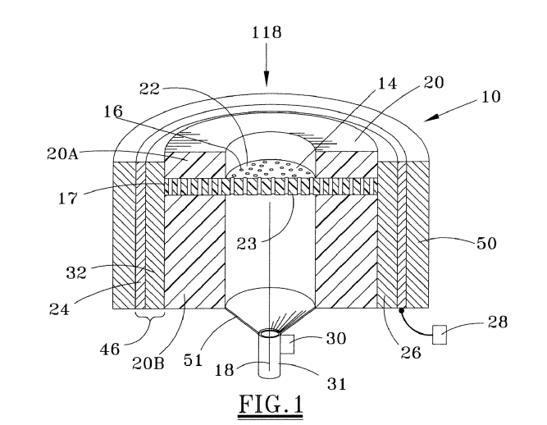
Nasa CNT and Ultrasonic Patent

Slide 32
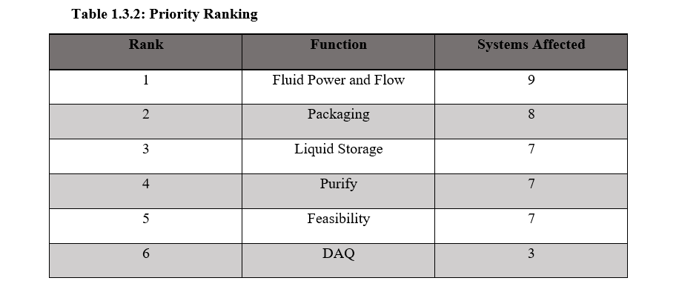
Functional Decomp Priority Rating

Slide 33
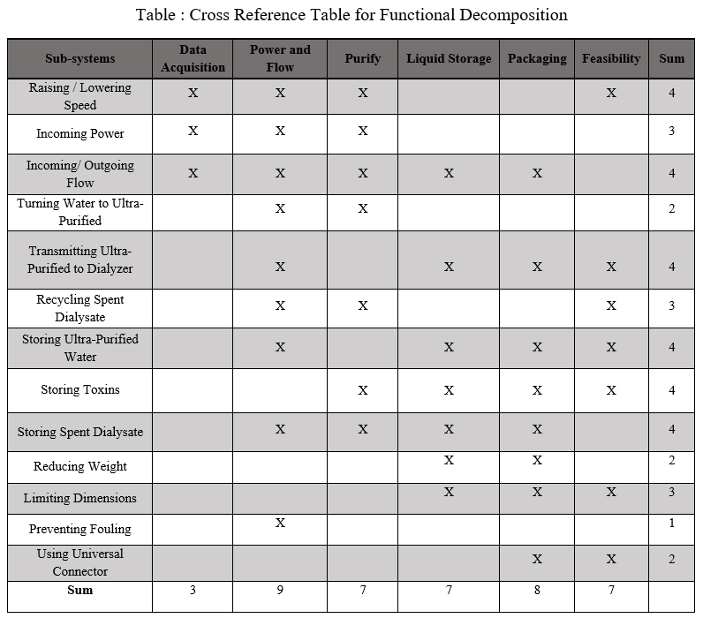
Functional Decomp Cross Reference

Slide 34
Calculations for Laminar Flow
$$ρ=1000 \frac{kg}{m^{3}} , v= ?, average diameter of a nanotube d=2.0 x {10}^{−9} ,$$
$$μ=0.0008891 \frac{N∗s}{m^{2}}$$
$Re$ = $\frac{ρvd}{μ}$
To find the velocity:
Given, by our customer, a flow rate of $1000 \frac{mL}{min}$
1000 ${mL}/{min}$ $→$ converted to $1.67 x {10}^{−5}{m^{3}}/s$
$1.67 x {10}^{−5}{m^{3}}/s$ $→$ converted to $5.32 x {10}^{3}\frac{m}{s}$
$$Re= \frac{(1000 \frac{kg}{m^{3}})(5.32 x {10}^{3}\frac{m}{s})(2.0 x {10}^{−9})}{(0.0008891 \frac{N∗s}{m^{2}})}$$
$Re≈12$, indicating a Laminar Flow

Slide 35
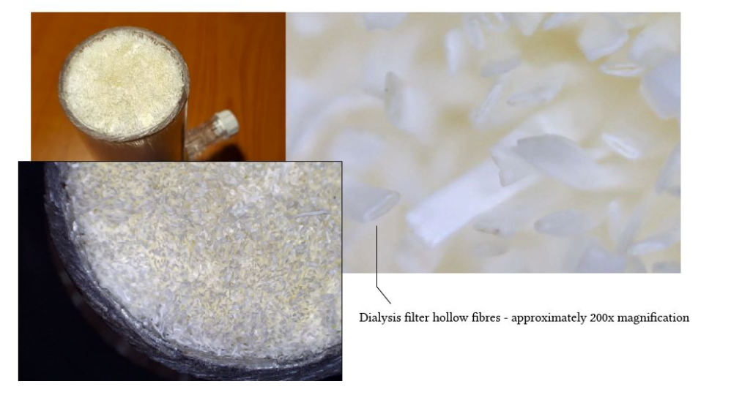
What a Dialyzer Looks Like

Slide 36
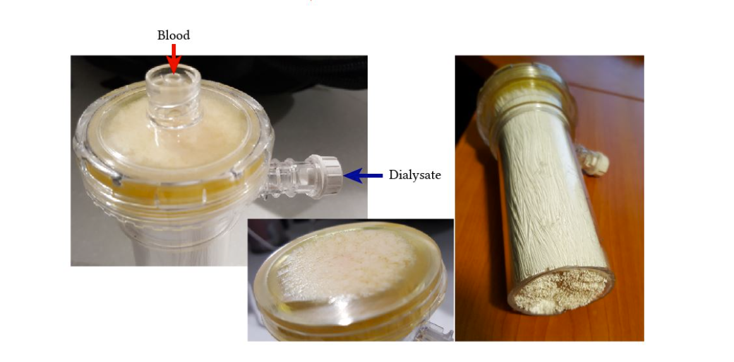

Slide 37
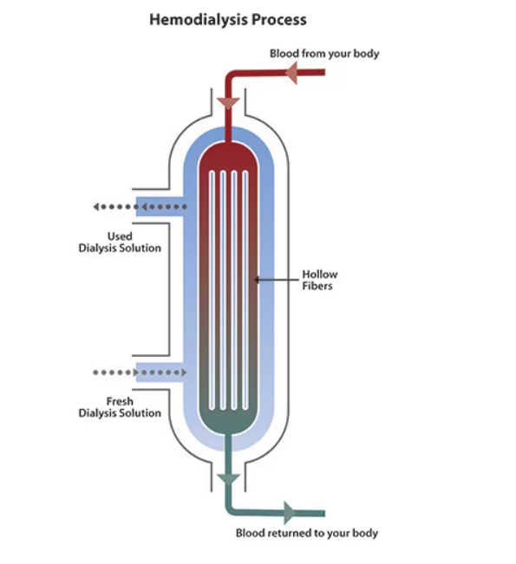

Slide 38
Hemodialysis and Peritoneal
Hemodialysis is ongoing dialysis (3 to 5 times a week) that cleans your blood, usually in a dialysis center. The hemodialysis access is in your arm.
Peritoneal dialysis is ongoing dialysis (daily) that collects waste from the blood by washing the empty space in the abdomen (peritoneal cavity). It can be done from home. The access for this is in your abdomen.

Slide 39
Reasons Why
The spent dialysate is a highly saline liquid consisting of urea, creatinine, uric acid, phosphate, etc.
A major challenge for the reuse of spent dialysate is removal of urea, the main nitrogenous waste product.
Due to its small molecular weight (60 Da) and electroneutral nature, it is difficult to be removed by sorbents.
Key Drawbacks:
System complexity
High energy cost
Membrane fouling and scaling

Slide 40
Current System Schematic
Kencin Autry
Ultra-Pure Runoff
Dialysis Machine
Water Supply
Filter
Dialysate Runoff
Notes:
*include specific parts we’ve ordered
Water supply will need to include the RO system
Filter will need to to be the CNT membrane
Pumps and piping being used

Slide 41
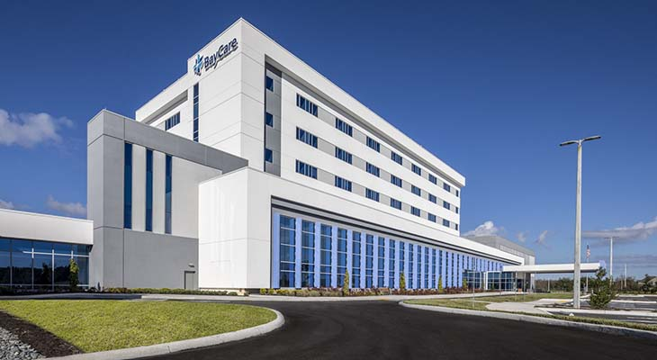
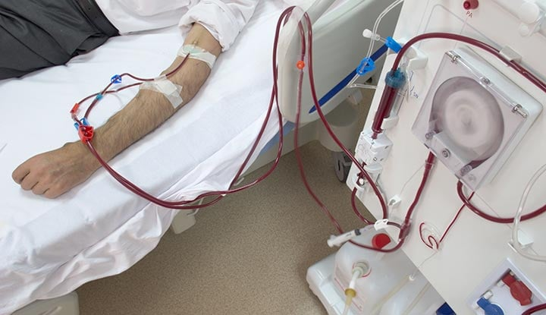
Timothy Norman
Primary Markets
Hospitals and Medical Care Facilities
At-home patients
41

Slide 42
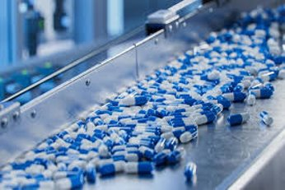
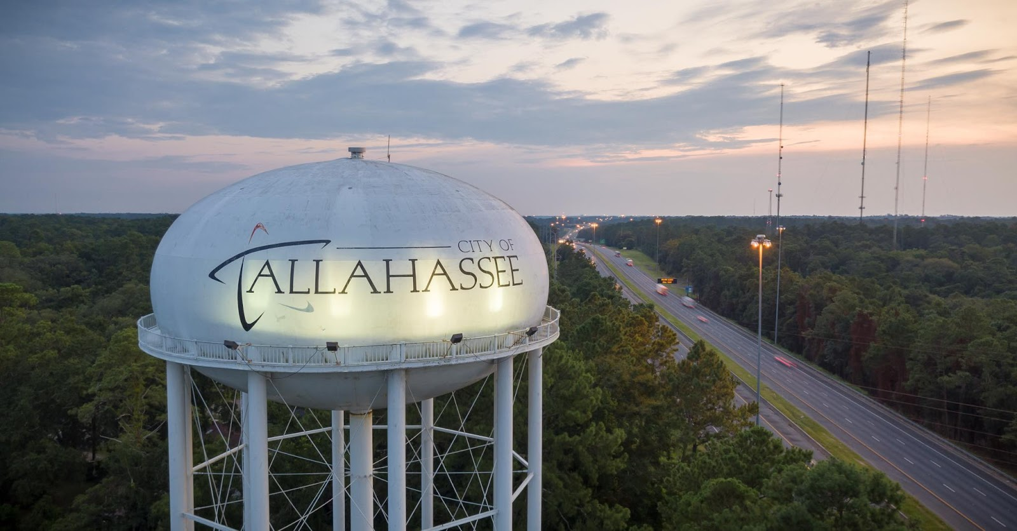
Timothy Norman
Secondary Markets
Nursing and Retirement Care
Pharmaceuticals
City Water Treatment
Food Manufacturing
42

Slide 43
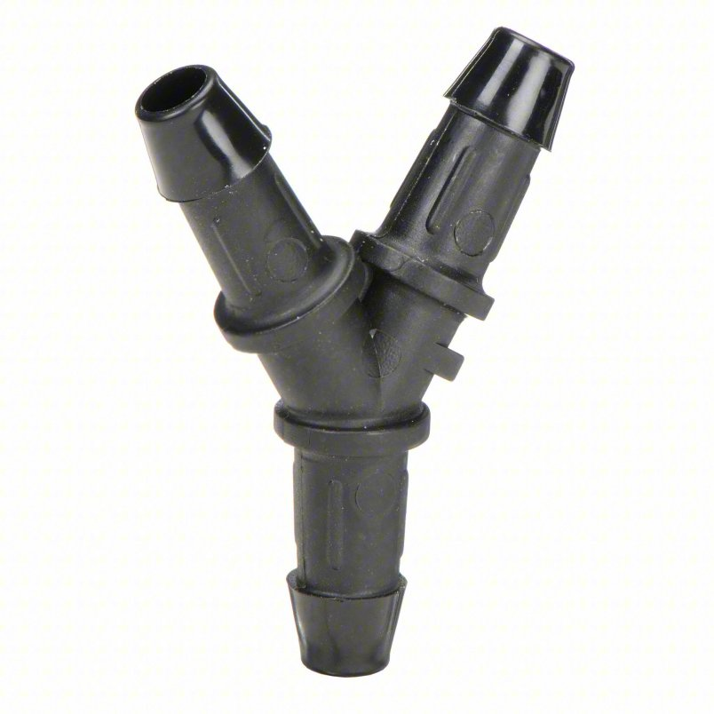

Slide 44
This is 10-point
This is 15–point Times
This is 20–point
This is 25–point
This is 30–point
This is 35–point
This is 40–point
This is 50–point
This is 60–point
This is 72–point
Notes:
Use at least 20-point font in Room A105, B134, and B136
Use at least 25-point font in Room B135

Slide 46
Notes:
Filter process design

Slide 48
Lily Thompson
Assumptions
Hemodialysis and peritoneal will be the main medical processes the system is used for
The system will only be used by one patient at a time
The incoming flow is laminar
48

Slide 49
College of Engineering Color Palette
1 2 3 4
Pantone: PMS 195 C
RGB: 120, 47, 64
Hex: #782F40
CMYK:19, 90, 50, 55
1 2 3 4
Pantone: Black C
RGB: 0, 0, 0
Hex: #000000
CMYK:0, 0, 0, 100
Garnet
Black
1 2 3 4
RGB: 238, 118, 36
Hex: #EE7624
CMYK:2, 66, 99, 0
1 2 3 4
Pantone: PMS 000C
RGB: 255, 255, 255
Hex: #FFFFFF
CMYK: 0, 0, 0, 0
Fang
Orange
White
Notes:
Avoid 75% Black in B135

Slide 50
Accent Color Palette
1 2 3 4
RGB: 0, 59, 111
Hex: #003B6F
CMYK:
1 2 3 4
RGB: 0, 59, 111
Hex: #003B6F
CMYK:
1 2 3 4
RGB: 251, 236, 93
Hex: #FBEC5D
CMYK:
1 2 3 4
RGB: 219, 215, 210
Hex: #DBD7D2
CMYK:
1 2 3 4
RGB: 251, 236, 93
Hex: #FBEC5D
CMYK:
1 2 3 4
RGB: 219, 215, 210
Hex: #DBD7D2
CMYK:
Tardis Blue
Tardis Blue
Corn
Timberwolf
Corn
Timberwolf
1 2 3 4
RGB: 206, 0, 88
Hex: #CE0058
CMYK: 0, 100, 43, 12
1 2 3 4
RGB: 206, 0, 88
Hex: #CE0058
CMYK: 0, 100, 43, 12
1 2 3 4
RGB: 104, 40, 96
Hex: #682860
CMYK:
1 2 3 4
RGB: 220, 220, 220
Hex: #DCDCDC
CMYK:
Rubine Red
Rubine Red
Imperial
Gainsboro
1 2 3 4
RGB: 72, 146, 155
Hex: #48929b
CMYK:
1 2 3 4
RGB: 64, 224, 208
Hex: #40E0D0
CMYK:
1 2 3 4
RGB: 255, 139, 0
Hex: #FF8B00
CMYK:
Asagi-iro
Turquoise
American Orange
Notes:
Remove American orange add hyperlink grey
Make corn the last for b135
All work in 134 imperial move later
Tardis doesn’t work in b136

Slide 51
F7AB19
D67F15
EE7624
D64615
F73119
Analogous
https://color.adobe.com/create/color-wheel
6E3610
F0A16C
EE7624
6E4931
BASB1C
Monochromatic
A14508
4BED3B
EE7624
250CED
2010A1
Triad
A1470C
FF8C40
EE7624
0098A1
24E2ED
Complementary
28A164
2FED8D
EE7624
0848A1
1871ED
Split Complementary
EDAC2F
3BED93
EE7624
0C6AED
ED2F18
Double Split Complementary
ED660C
C7ED3B
EE7624
0CE1ED
A418ED
Square
BA7E09
87724A
EE7624
60EFCF
09BA61
Compound
AD551A
6E3610
EE7624
FA7625
D46820
Shades
Notes:
These are the variants that work well with Fang Orange. The bolded items show well on the projectors.

Slide 52
85412D
8F3831
782f40
8F3176
792D85
Analogous
https://color.adobe.com/create/color-wheel
C44D69
8E626D
782F40
C48796
451B25
Monochromatic
C43959
78743B
782F40
236178
43A2C4
Triad
C43959
C46078
782F40
25C43D
2F783A
Complementary
93C460
577835
782F40
39C49D
297861
Split Complementary
784435
5A783B
782F40
237860
6E2978
Double Split Complementary
782337
78683b
782F40
237830
293978
Square
AB4D32
DEBAAF
782F40
5D8555
70AB32
Compound
38161E
C44D69
782F40
853447
5E2532
Shades

Slide 53
A105
A105
B135 Stage Left
B135 Stage Right
B136
B134, A105
B135

Slide 59
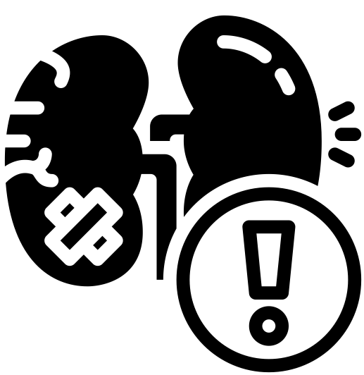
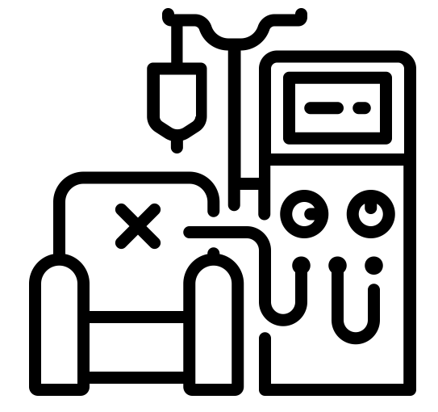
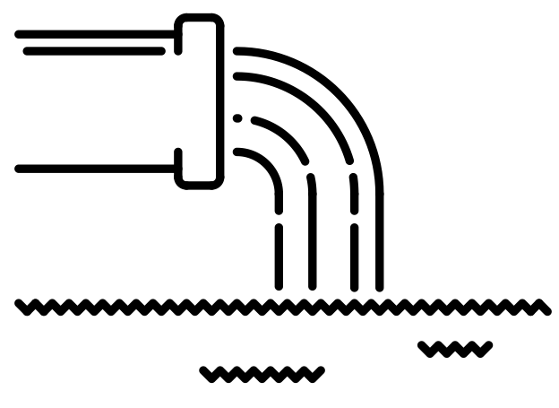
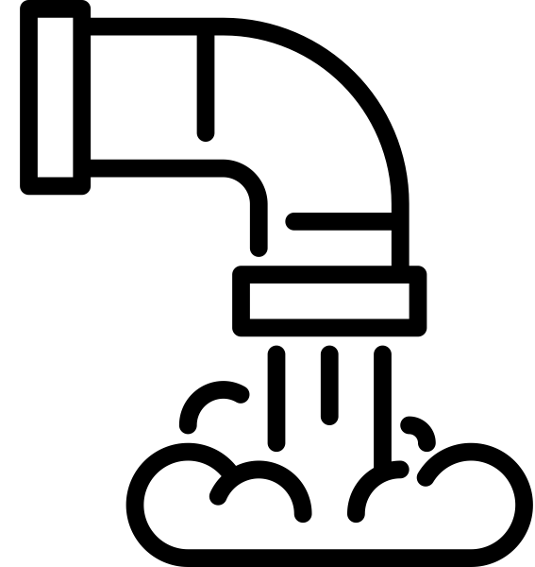
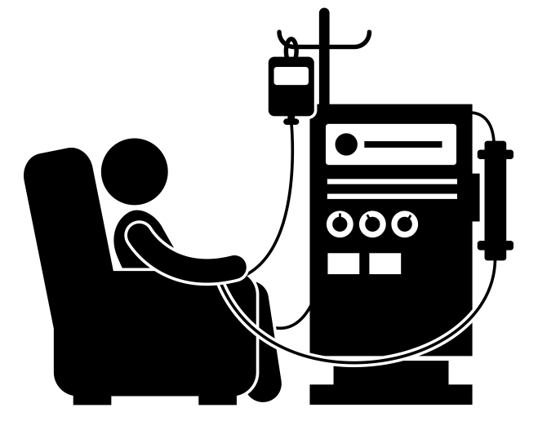
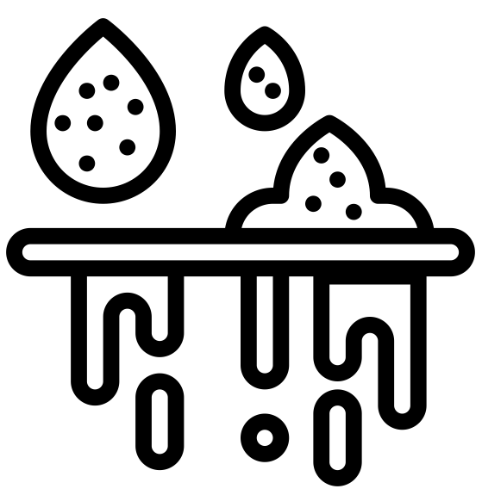
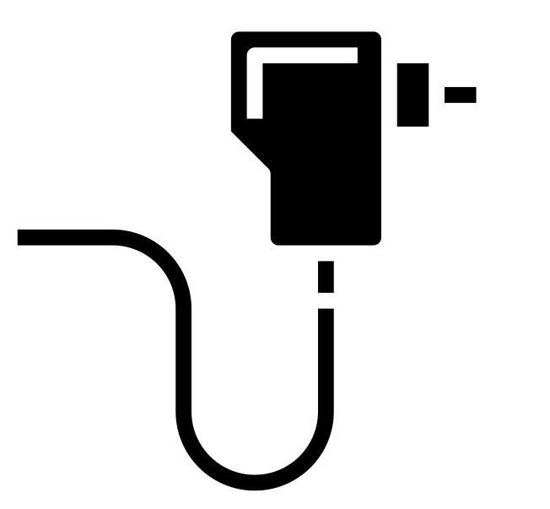
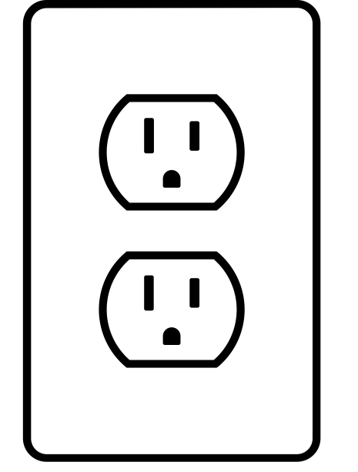
Logos and icons

Slide 60
Citations
blood dialysis by Andy Horvath from <a href="https://thenounproject.com/browse/icons/term/blood-dialysis/" target="_blank" title="blood dialysis Icons">Noun Project</a> (CC BY 3.0)
Kidney by Febrian Hidayat from <a href="https://thenounproject.com/browse/icons/term/kidney/" target="_blank" title="Kidney Icons">Noun Project</a> (CC BY 3.0)
Dialysis Machine by bsd studio from <a href="https://thenounproject.com/browse/icons/term/dialysis-machine/" target="_blank" title="Dialysis Machine Icons">Noun Project</a> (CC BY 3.0)
Dialysis Machine by Gan Khoon Lay from <a href="https://thenounproject.com/browse/icons/term/dialysis-machine/" target="_blank" title="Dialysis Machine Icons">Noun Project</a> (CC BY 3.0)
filter by Smalllike from <a href="https://thenounproject.com/browse/icons/term/filter/" target="_blank" title="filter Icons">Noun Project</a> (CC BY 3.0)
filter by Kiran Shastry from <a href="https://thenounproject.com/browse/icons/term/filter/" target="_blank" title="filter Icons">Noun Project</a> (CC BY 3.0)
filter by Kiran Shastry from <a href="https://thenounproject.com/browse/icons/term/filter/" target="_blank" title="filter Icons">Noun Project</a> (CC BY 3.0)
Waste by lastspark from <a href="https://thenounproject.com/browse/icons/term/waste/" target="_blank" title="Waste Icons">Noun Project</a> (CC BY 3.0)
Waste by lastspark from <a href="https://thenounproject.com/browse/icons/term/waste/" target="_blank" title="Waste Icons">Noun Project</a> (CC BY 3.0)
Adapter by mynamepong from <a href="https://thenounproject.com/browse/icons/term/adapter/" target="_blank" title="Adapter Icons">Noun Project</a> (CC BY 3.0)
Outlet by Darrin Loeliger from <a href="https://thenounproject.com/browse/icons/term/outlet/" target="_blank" title="Outlet Icons">Noun Project</a> (CC BY 3.0)
Water Filter by I Putu Dicky Adi Pranatha from <a href="https://thenounproject.com/browse/icons/term/water-filter/" target="_blank" title="Water Filter Icons">Noun Project</a> (CC BY 3.0)
Water Filter by Phonlaphat Thongsriphong from <a href="https://thenounproject.com/browse/icons/term/water-filter/" target="_blank" title="Water Filter Icons">Noun Project</a> (CC BY 3.0)
water treatment by Soremba from <a href="https://thenounproject.com/browse/icons/term/water-treatment/" target="_blank" title="water treatment Icons">Noun Project</a> (CC BY 3.0)
water treatment by Soremba from <a href="https://thenounproject.com/browse/icons/term/water-treatment/" target="_blank" title="water treatment Icons">Noun Project</a> (CC BY 3.0)
Faucet by Uswa KDT from <a href="https://thenounproject.com/browse/icons/term/faucet/" target="_blank" title="Faucet Icons">Noun Project</a> (CC BY 3.0)
IV Bag by Ralf Schmitzer from <a href="https://thenounproject.com/browse/icons/term/iv-bag/" target="_blank" title="IV Bag Icons">Noun Project</a> (CC BY 3.0)
Reservoir by Adrien Coquet from <a href="https://thenounproject.com/browse/icons/term/reservoir/" target="_blank" title="Reservoir Icons">Noun Project</a> (CC BY 3.0)

Slide 61
Citations
R. Nystrand Microbiology of water and fluids for hemodialysis J. Chin. Med. Assoc., 71 (5) (2008), pp. 223-229
J.W.M. Agar Conserving water in and applying solar power to haemodialysis: ’Green Dialysis’ through wiser resource utilization Nephrology, 15 (4) (2010), pp. 448-453
https://www.umms.org/ummc/health-services/kidney/dialysis/types#:~:text=Hemodialysis%20is%20ongoing%20dialysis%20(3,can%20be%20done%20from%20home.

